Slide 1




Machine Learning for Neuroscience

Slide 2

What will you learn?
Preprocessing, Analysing Data
Modelling + Predicting Patterns
Linear + Non-Linear Dimensionality Reduction
VAEs
Classification
Regression
Linear Models
Artificial Neural Networks

Slide 3
Representing data (the basics)
When you learn to code we have these main data types:
Boolean, integer, float, string
In ML we typically work with numeric values.
Even language based modules use numeric representations of words such as word vectorization

Slide 4
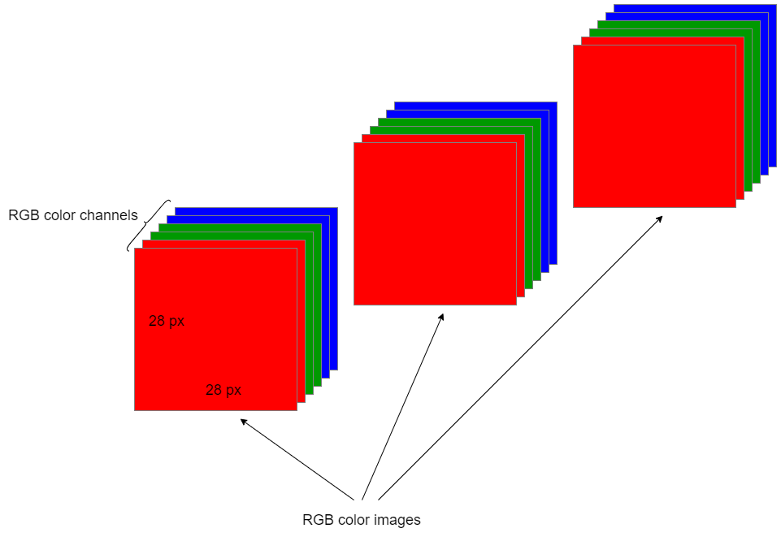
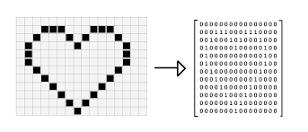
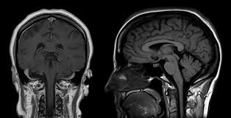
Images (the basics)
Images are matrices
An image can be represented numerically as a matrix (or a multi-dimensional array)
Standard Images:
Grayscale: H × W : each pixel is 0–255 intensity;RGB color: H × W × 3: each pixel is (R, G, B), 0–255 per channel
Neuroscience Images:
MRI – Structural brain scan (X × Y × Z)
Histology / Microscopy – Tissue slices or volumes (H × W or X × Y × Z)
Values are usually continuous (e.g. intensity, density), not just 0–255
Notes:
Calcium imaging -> dict of fluorescence values over time

Slide 5
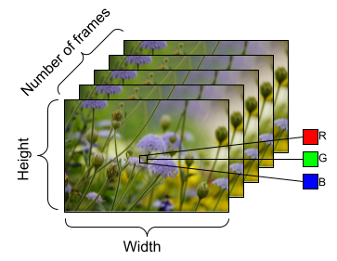
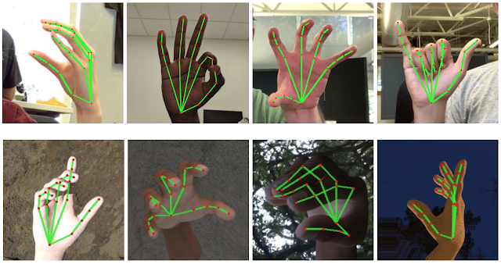
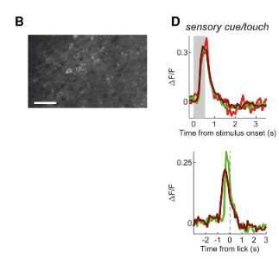
Videos/ Time-series data
Arrays of images
Can be treated as time-series data depending on the task
Neuroimaging Data (e.g. fMRI, calcium imaging):
Also representable as matrices or tensors (multi-dimensional arrays).
Common formats:fMRI: 4D → X × Y × Z × T (3D brain volumes over time)
Calcium imaging: 3D → H × W × T (2D field of view over time)
Values are typically continuous (e.g., fluorescence intensity), not 0–255

Slide 6

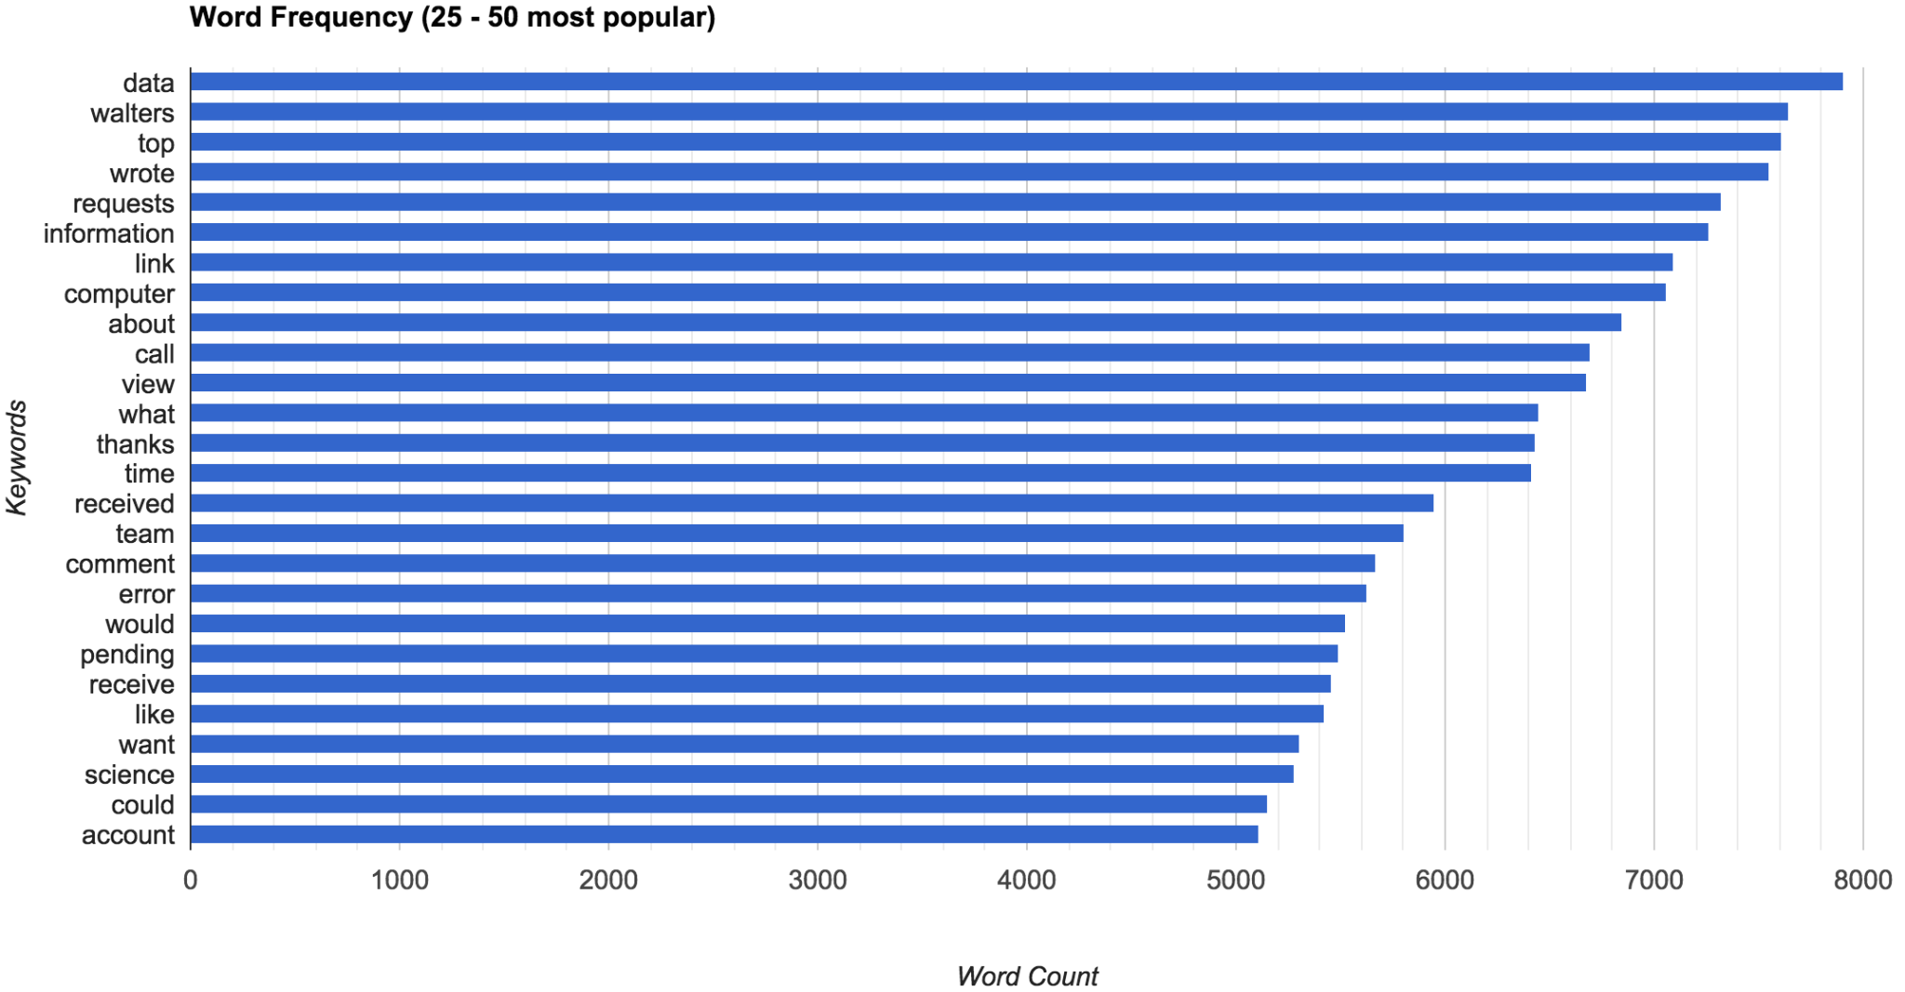
Text/ strings
Much data is in the form of text which is a complex problem
Classification with language can be done in a number of ways

Slide 7
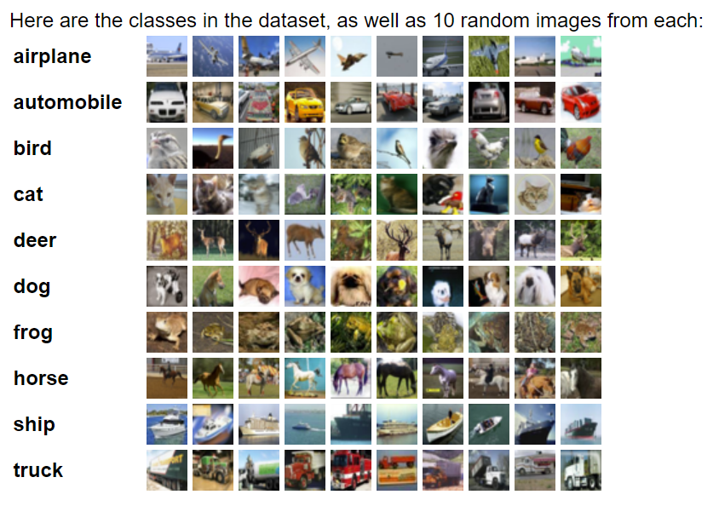
Data sets
A data set is a collection of related data
In ML, models typically require the same number of inputs each time.
Image = (200,200) = 40,000 pixels
Model inputs: 40,000
Model outputs: 10 classes
Notes:
Cifar 10

Slide 8
Dimensionality Reduction and VAEs

Slide 9
Contents
Why dimensionality reduction - why in CompNeuro?
Methods:
Linear Dimensionality Reduction - PCA
Nonlinear Dimensionality Reduction - t-SNE,UMap,VAEs

Slide 10
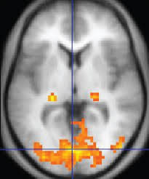
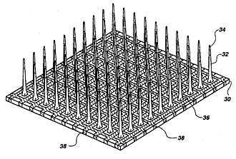
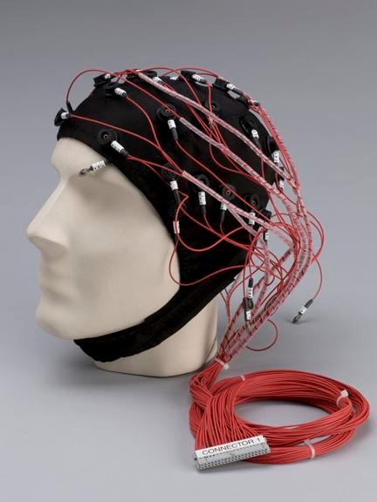
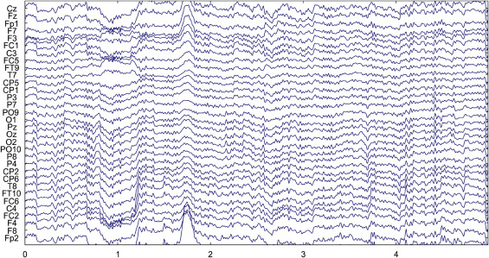
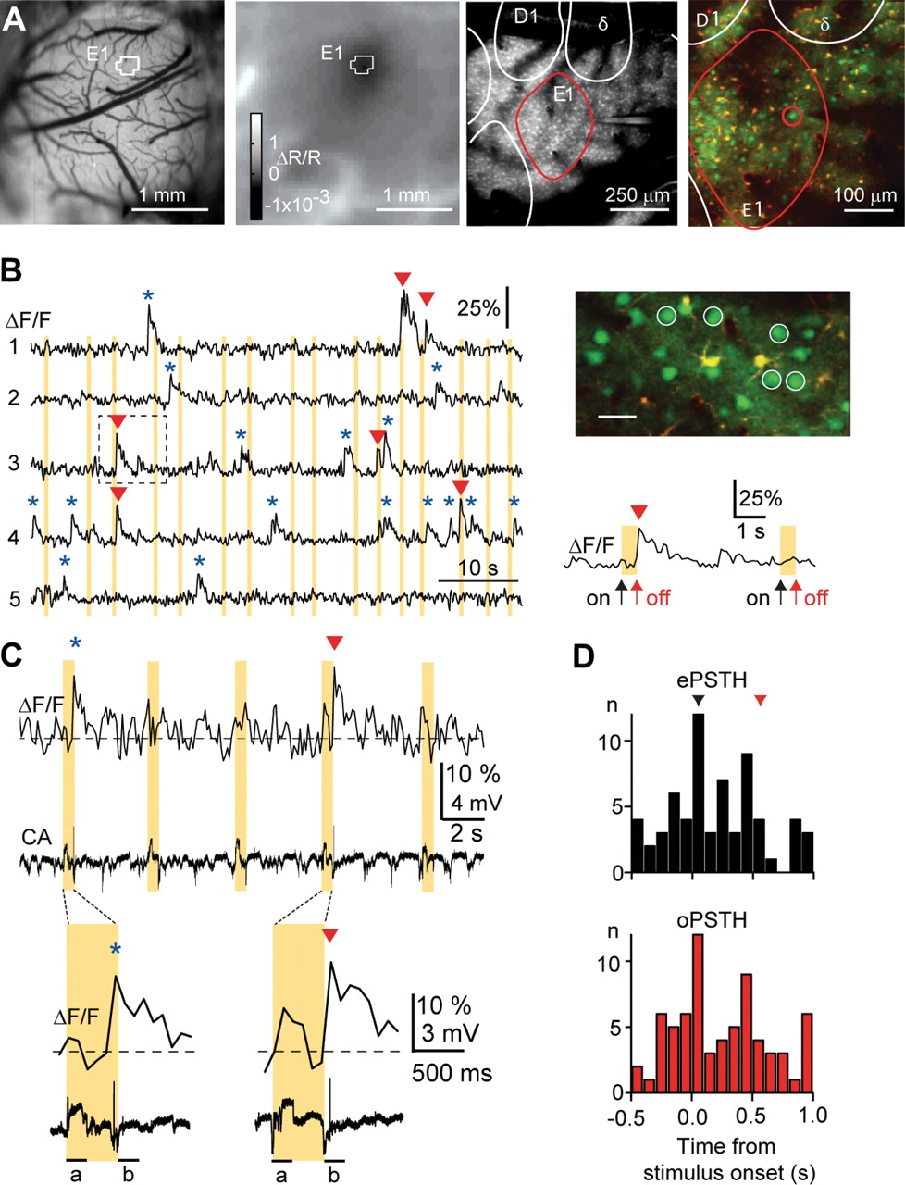
Why Dimensionality Reduction in Neuroscience?
fMRI
Multi-Electrode Arrays
Multi- Dimensional Neural Data:
What is the most meaningful aspect?
Optical Imaging
EEG
Notes:
Technology to monitor individual neurons: multi-electrode arrays(insert multiple electrodes at the same time - record from them), optical imaging
Calcium measurement from a population of neurons from a different experiment than in A (scale bar, 30 μm). Fluorescence traces from five simultaneously recorded PW-related L2/3 neurons showing spontaneous (blue asterisks) and sensory-evoked (red arrowheads) calcium transients. Calcium transients were classified as sensory evoked if the initial fluorescence rise and peak occurred within 200 ms after either the onset (away from resting position) or the offset (return to resting position) of the whisker deflection. Note that not all whisker deflections evoke calcium transients. Yellow bars indicate stimulation periods. An example calcium transient associated with offset stimulation is shown on expanded timescale.
In experiments -> recording neuronal activity for 10s of neurons for a task

Slide 11

Dimensionality reduction
Volume of Ball
Starting Position
Physics of the world
vs
Video of Ball falling:
Millions of pixel values
Very few variables
High-Dimensional Explanation
Low-Dimensional Explanation
Notes:
Neurons form network -> neuron cannot act independently
Degrees of freedom of brain smaller than nr. of neurons
Left: video of ball falling, right: explanation in physics terms
-> but what if we are on mars, model wrong -> need to know what types of

Slide 12
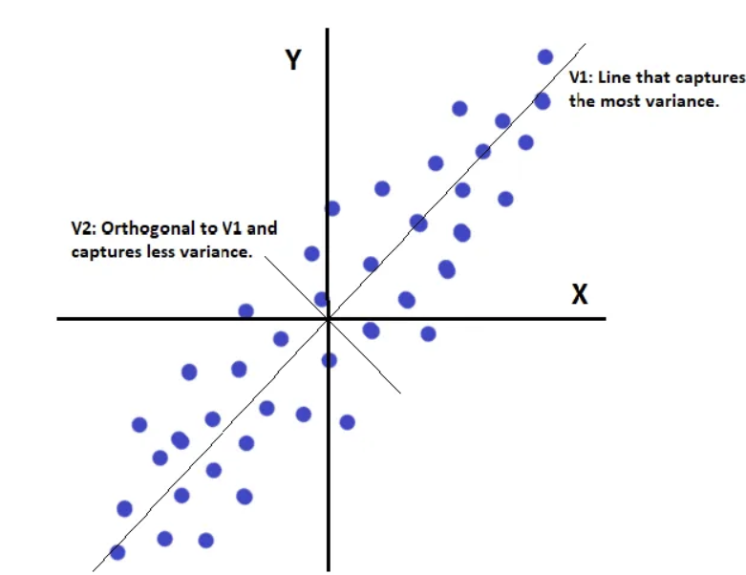
Principal component analysis
Principal components are new variables that are constructed as linear combinations or mixtures of the initial variables.
In simple terms it is reducing the number of variables from a data set - potentially at the cost of accuracy
This method helps in identifying the directions (or components) in which the data varies the most
Notes:
the general idea of pca is to reduce the scale of the data by transforming it into a new coordinate system (principal components) where the variance of the data along each axis is maximized, allowing for a more efficient representation of the original data with fewer dimensions.
PCA is a technique used to reduce the number of dimensions in a dataset while retaining as much of the original variance as possible by transforming the data into a new set of uncorrelated variables called principal components.
Covariance is a measure that indicates the extent to which two random variables change together.

Slide 13
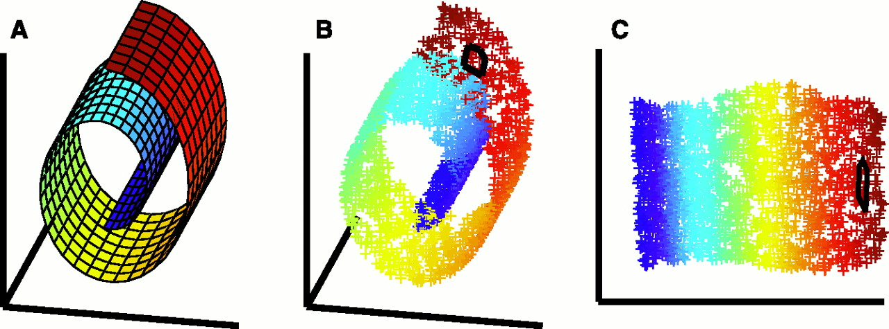
Non-Linear Dimensionality Reduction

Slide 14



Manifolds

Slide 15
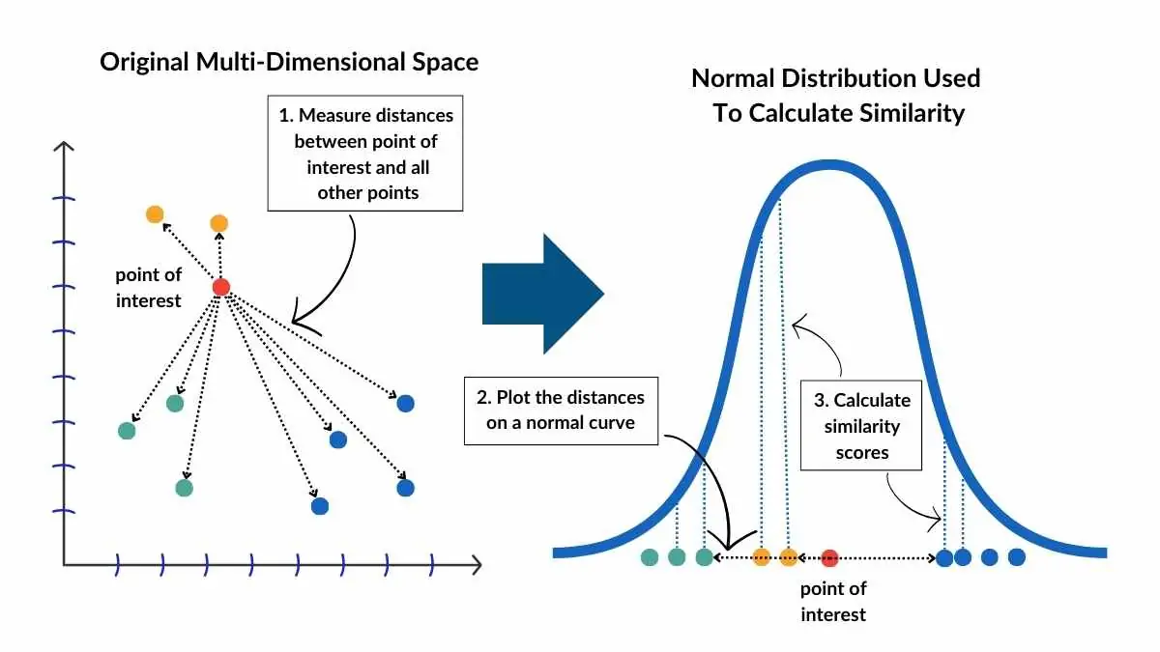
t-SNE
t-SNE is a nonlinear dimensionality reduction method used mainly for visualizing high-dimensional data in 2D or 3D.
It focuses on preserving local structure, meaning it keeps similar data points close together after reducing dimensions.
Unlike PCA, t-SNE does not create new axes as linear combinations. Instead, it builds a map that reflects the relative similarity between points, even if the original relationships are complex or nonlinear.
Notes:
the general idea of pca is to reduce the scale of the data by transforming it into a new coordinate system (principal components) where the variance of the data along each axis is maximized, allowing for a more efficient representation of the original data with fewer dimensions.
PCA is a technique used to reduce the number of dimensions in a dataset while retaining as much of the original variance as possible by transforming the data into a new set of uncorrelated variables called principal components.
Covariance is a measure that indicates the extent to which two random variables change together.

Slide 16
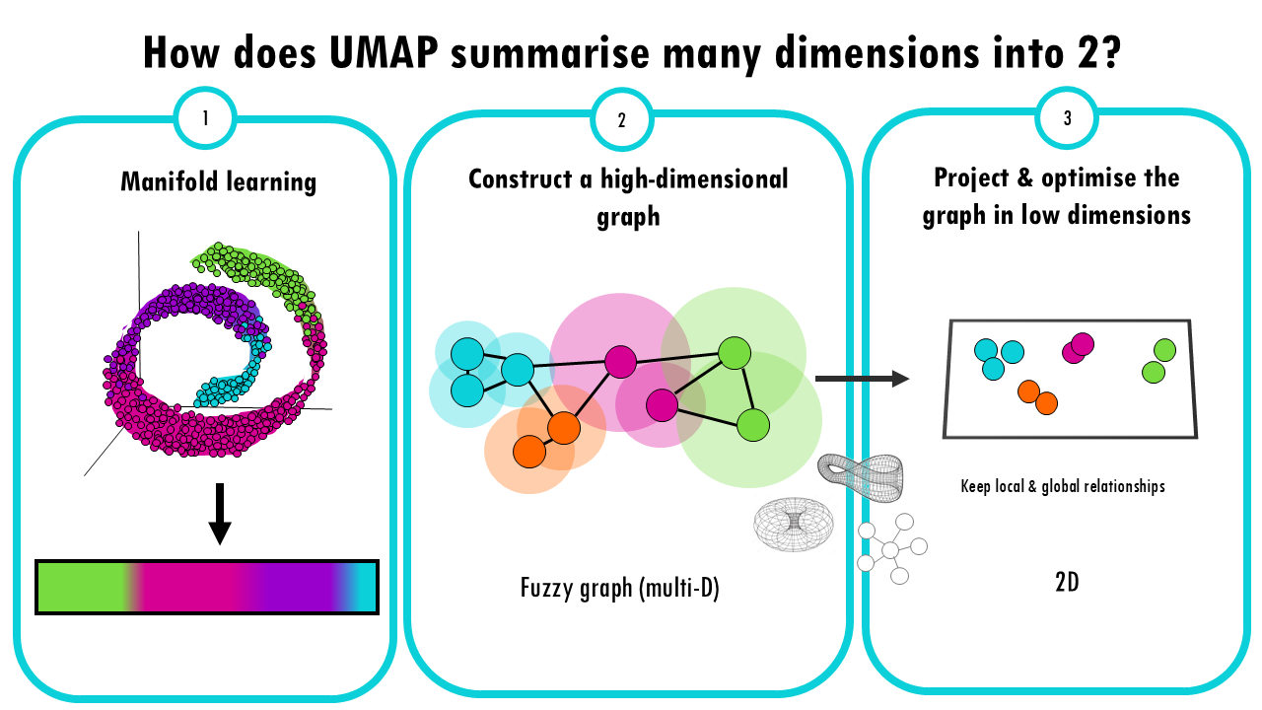
UMap
UMAP is a nonlinear dimensionality reduction method that, like t-SNE, is used to visualize high-dimensional data in 2D or 3D.
It aims to preserve both local and some global structure, making it better at maintaining the overall shape of the data.
Unlike PCA (linear) and t-SNE (local focus), UMAP builds a graph of neighborhood relationships and finds a low-dimensional space that best preserves those.
Notes:
the general idea of pca is to reduce the scale of the data by transforming it into a new coordinate system (principal components) where the variance of the data along each axis is maximized, allowing for a more efficient representation of the original data with fewer dimensions.
PCA is a technique used to reduce the number of dimensions in a dataset while retaining as much of the original variance as possible by transforming the data into a new set of uncorrelated variables called principal components.
Covariance is a measure that indicates the extent to which two random variables change together.

Slide 17
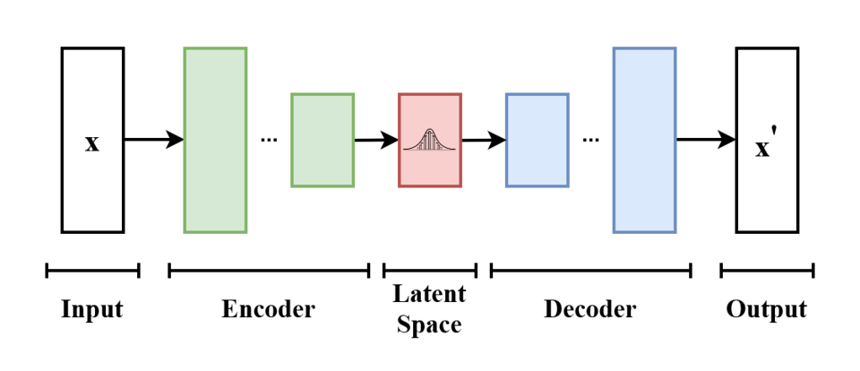
Variational Autoencoders (VAEs)
A VAE is a deep learning–based nonlinear method for dimensionality reduction and generative modeling.
It learns to compress data into a low-dimensional latent space and then reconstruct it from that space - guided by probabilistic encoding (outputs are distributions, not fixed points).

Slide 18
Choosing a method
Method | Type | Output | Best for
PCA | Linear | Axes of variance | Denoising, compression
t-SNE | Nonlinear | 3d/2d embeddings | Visualisation of local clusters
UMAP | Nonlinear | 3d/2d embeddings | Visualisation + structural relationships
VAE | Deep learning, nonlinear | Low-dim latent space + decoder | Modelling, simulation, generative tasks

Slide 19
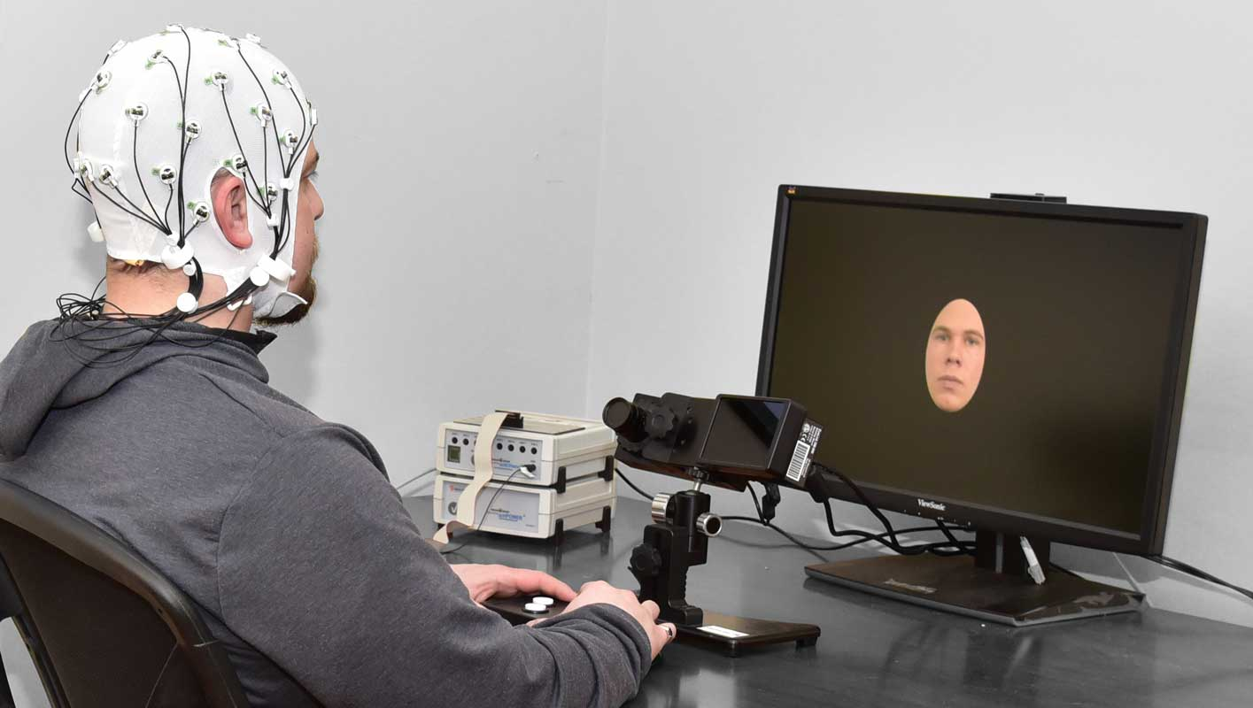
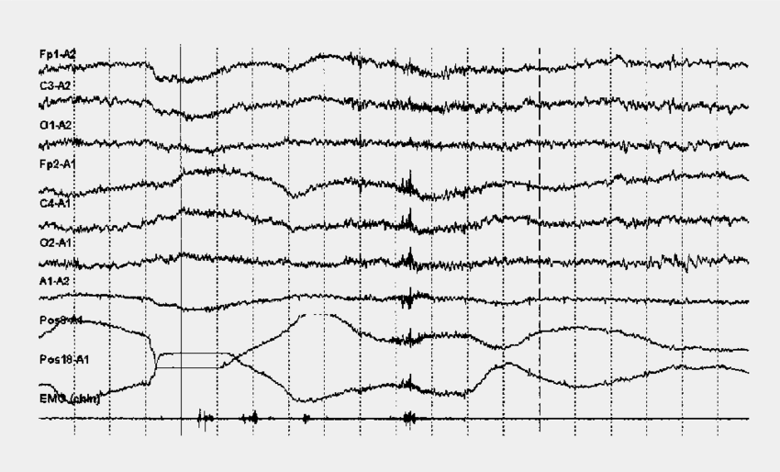
Problem 1:
Removing artifacts from EEG recordings
You have collected EEG data for studying attention during a visual task. However, EEG signals have artifacts (e.g., eye movement) you need to clean before analysis. What method should you use?
Answer:
PCA, because it is a linear method that separates signals based on their variance. Since artifacts like eye blinks cause large variance, PCA can isolate and remove them, helping clean EEG data before analysis.
Notes:
PCA

Slide 20
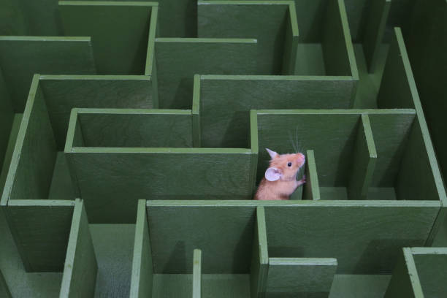
Problem 2:
Calcium Imaging – Find Brain States
You are studying hippocampal neural activity in mice during spatial navigation. You record from hundreds of neurons over multiple sessions and want to find a low-dimensional representation of the neural population that captures the temporal dynamics of place cell activity. Additionally, you want to reconstruct and generate realistic neural activity patterns to understand how spatial memories are encoded and replayed.
What method should you use?
Answer:
UMAP, because neural activity during decision-making is nonlinear and complex, and UMAP preserves both local clusters (to distinguish similar brain states) and global structure (to understand how these states relate across task phases like cue, decision, and movement), allowing you to clearly identify distinct brain states throughout the task.
Notes:
cropping

Slide 21
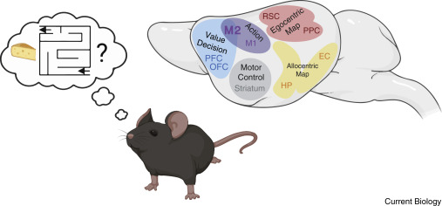
Problem 2:
Spatial Navigation over Time
You are studying how the hippocampus encodes spatial memories in mice during maze navigation. You record from hundreds of neurons over time and want to reduce this complex activity into a low-dimensional space that captures the temporal dynamics of neural firing. You also want to reconstruct or simulate neural activity patterns to study memory replay.
What method should you use?
Answer:
VAE, because it learns a nonlinear, low-dimensional latent space that captures both the structure and variability of neural data. It allows for dimensionality reduction, while also providing a decoder to reconstruct or generate realistic activity patterns.
Notes:
cropping

Slide 22
Labs

Slide 23
Worksheet
You will learn how to implement PCA, t-SNE,UMAP, and VAEs on a simple image dataset!
-> dim_red .ipynb on Github

